Slide 1
Planning/Planting for
FALL COLOR
IN NORTH TEXAS
Prepared by: Wanda Stutsman
Tarrant County Master Gardener

Slide 2
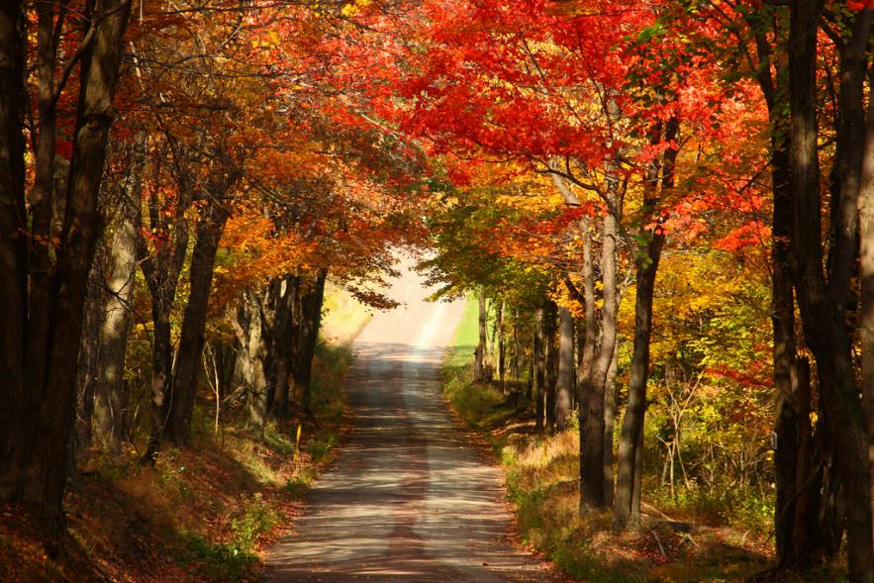
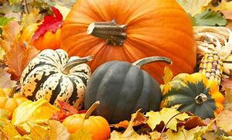
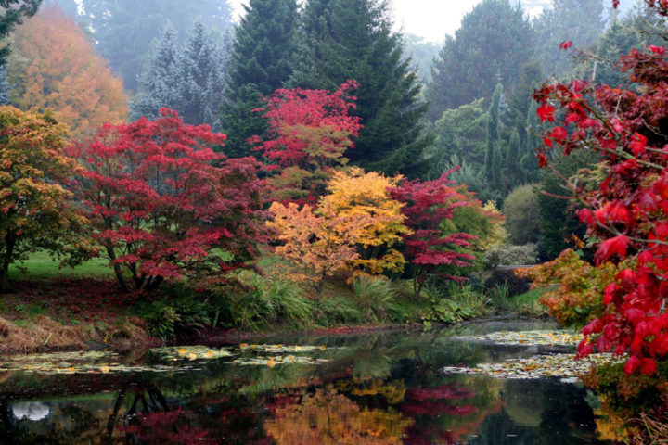
Images of FALL COLOR

Slide 3
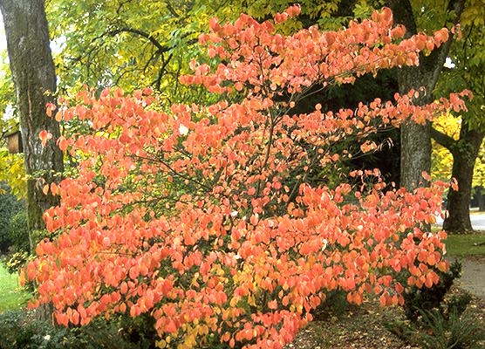
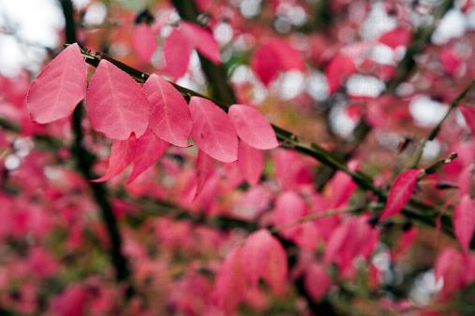
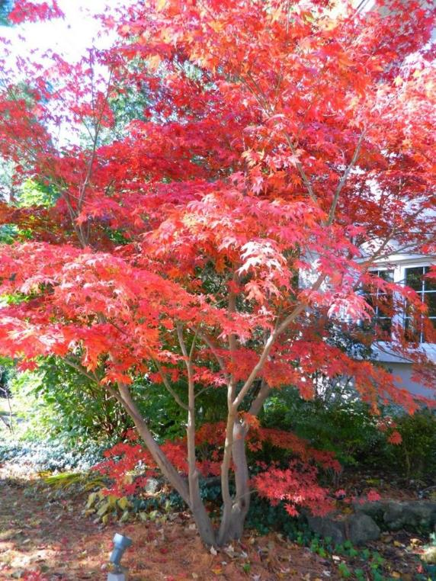
Eastern Dogwood
Rough Leaf Dogwood
Red
Japanese Maple
Rust
Orange

Slide 4
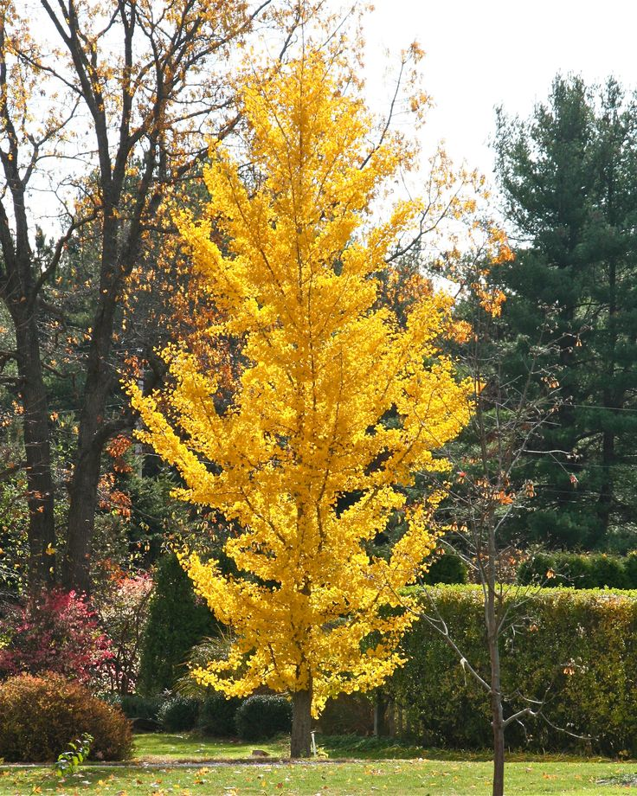
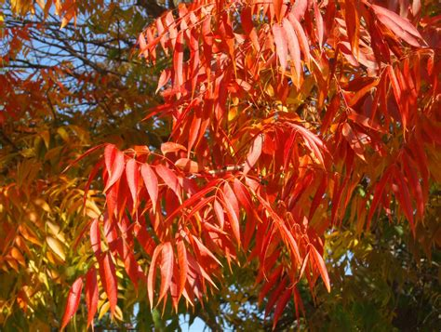
Rust
Yellow
Red
Chinese Pistache
Ginkgo Tree

Slide 5
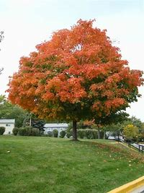
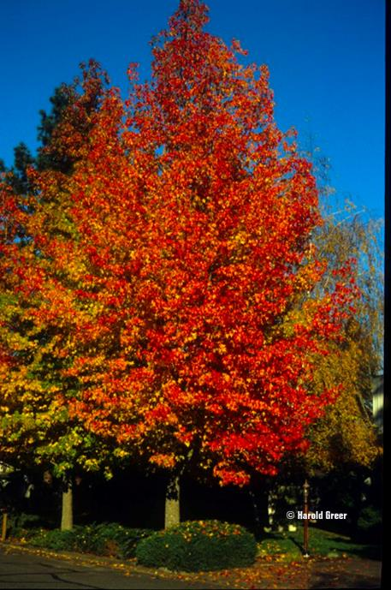
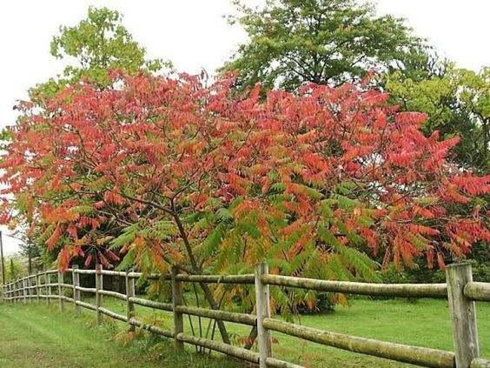
Sugar Maple
Rust
Green
Red
American Sumac
American
Sweet Gum

Slide 6
TRUE TEXAS FALL COLORS

Slide 7
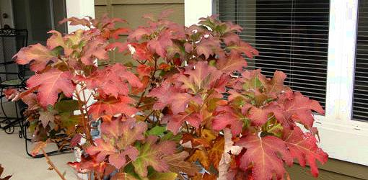
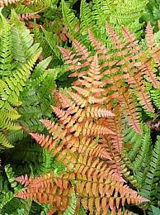
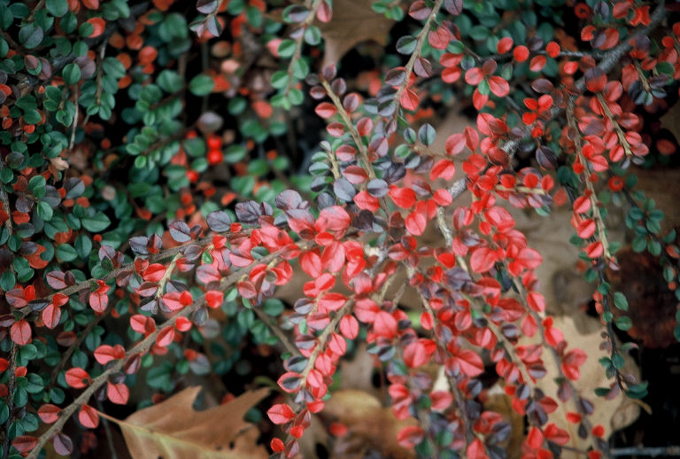
Rust
Oakleaf Hydrangea
Cotoneaster
Autumn fern

Slide 8
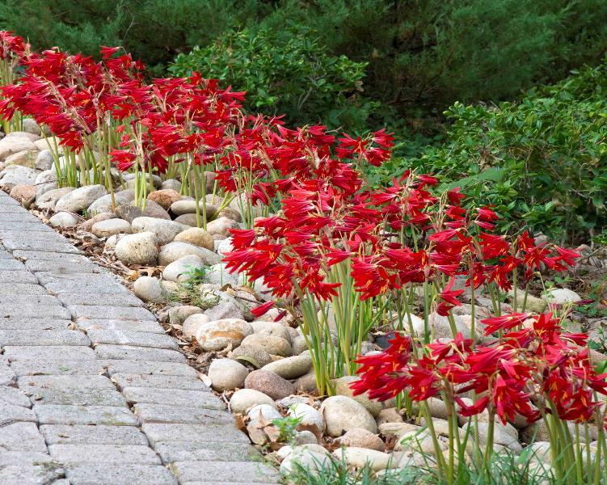
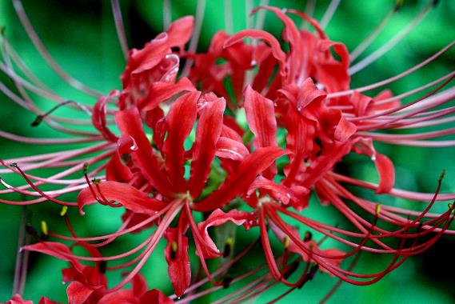
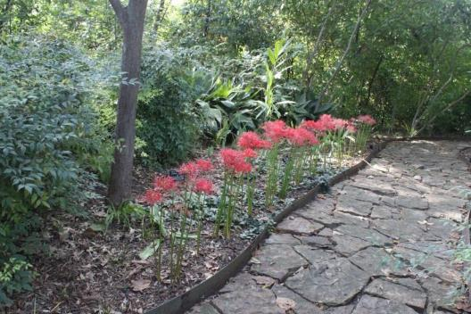
Red Oxblood
Schoolhouse Lily
Red
Red Spider Lily

Slide 9
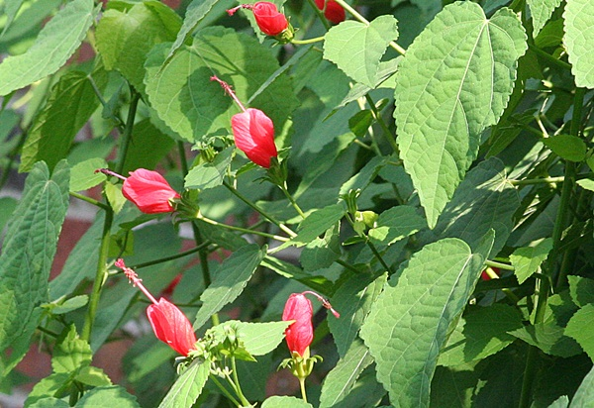
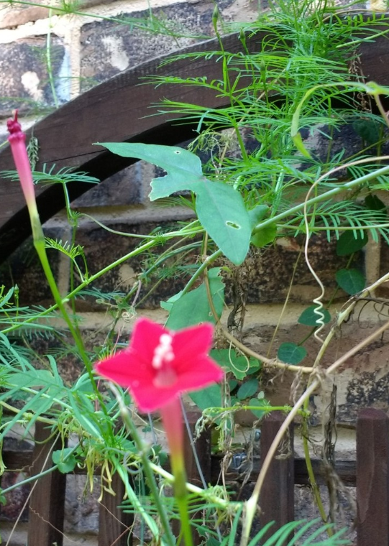
Red
Big Momma Red Turks Cap
Cypress Vine

Slide 10
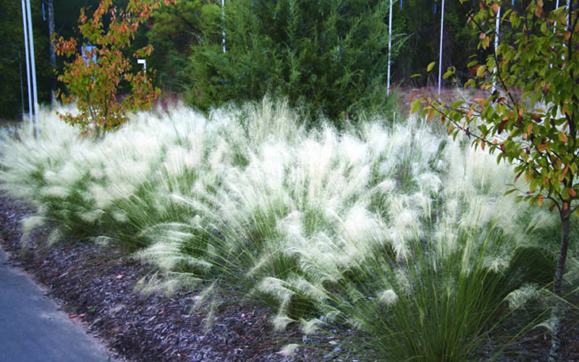
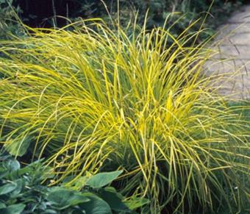
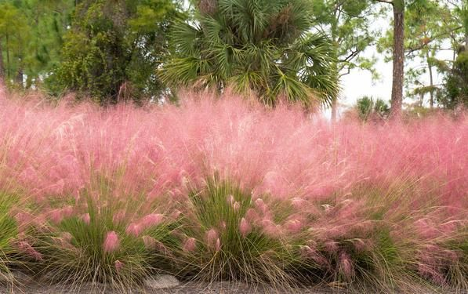
Pink
White
Green
Gold Sedge
Lindhiemer Muhly
Gulf Muhly

Slide 11
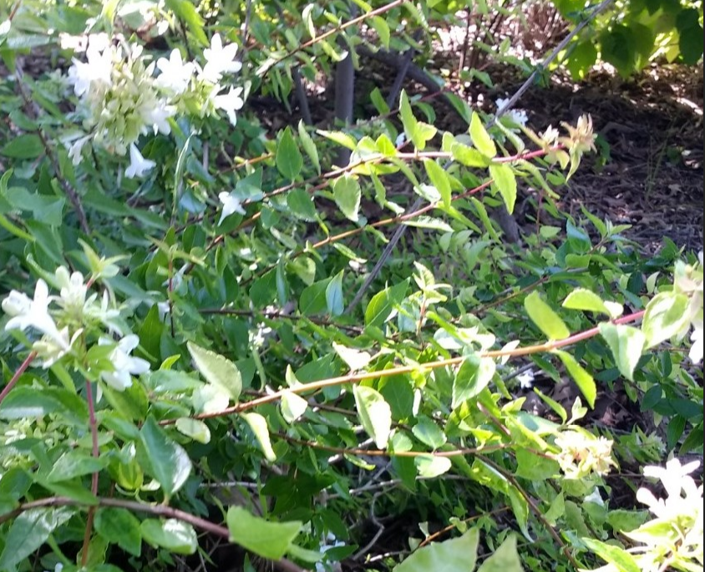
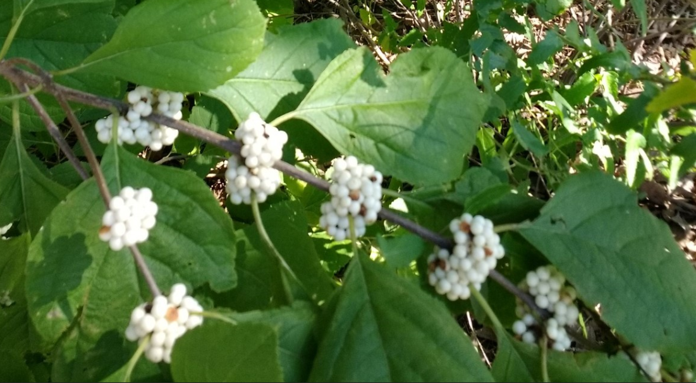
White
American Beautyberry White
Abelia, Kaleidoscope

Slide 12
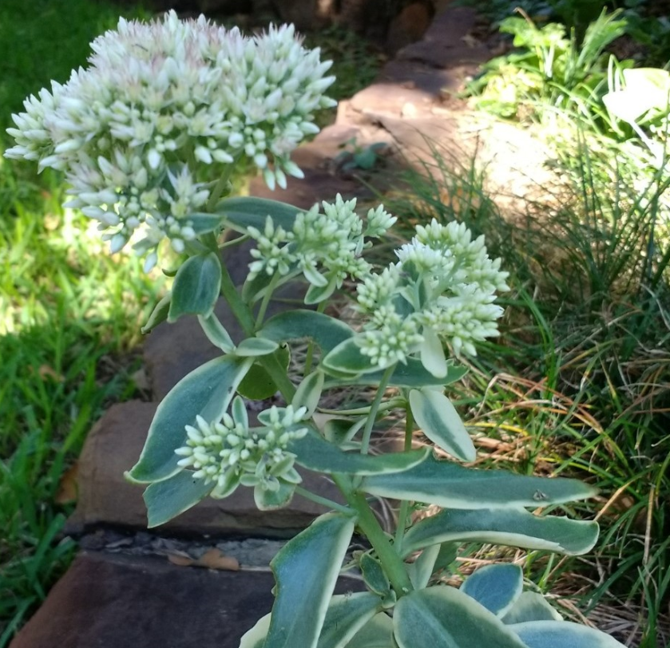
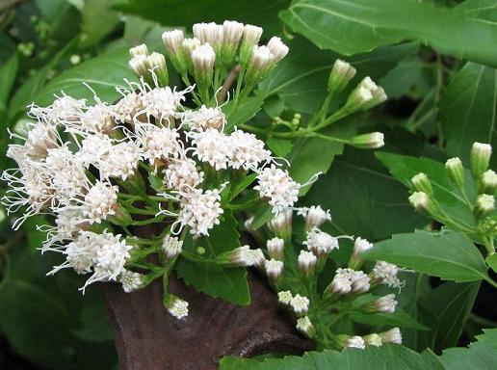
White
White Fragrant Mistflower
Stonecrop Sedum Variegated

Slide 13
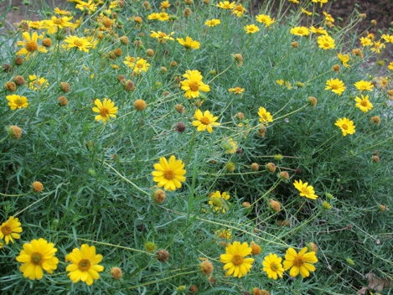
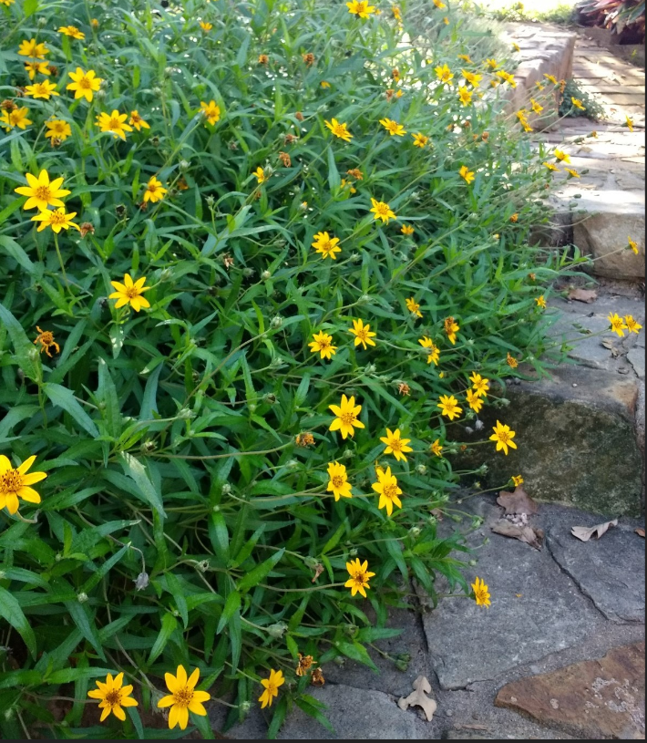
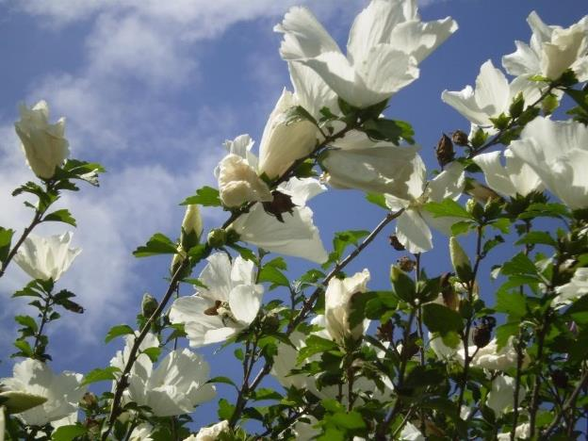
Skeleton-leaf Goldeneye
Yellow
White
Althaea, White
Zexmenia

Slide 14
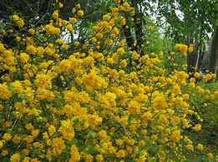
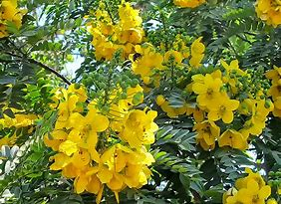
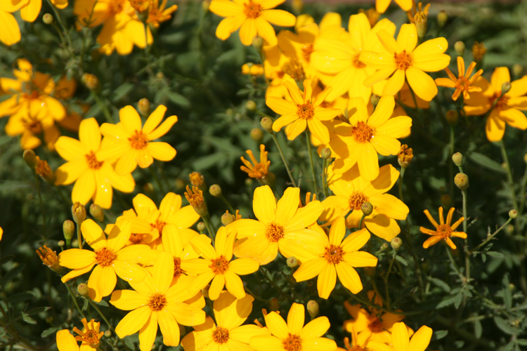
Yellow
Common Senna
Kerria Japonica
Double
Copper Canyon Daisy

Slide 15
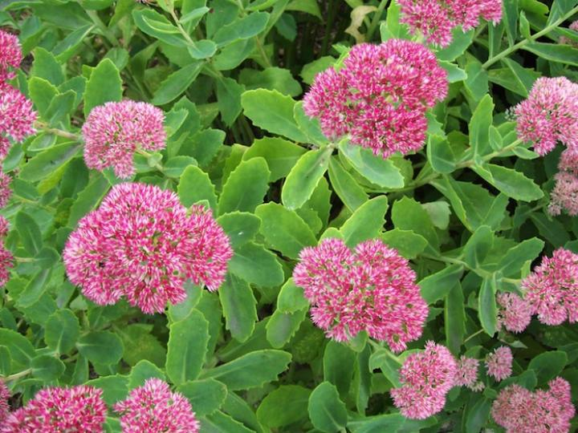
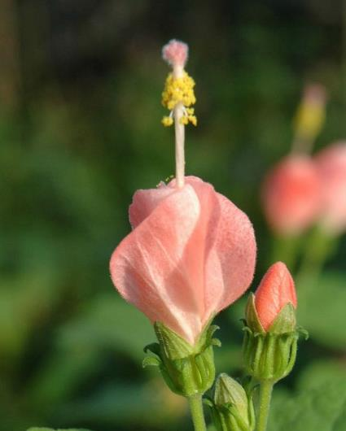
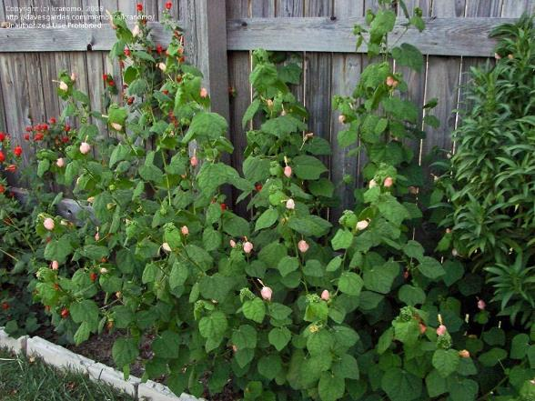
Pink
Pink Turks Cap
Stonecrop Sedum

Slide 16
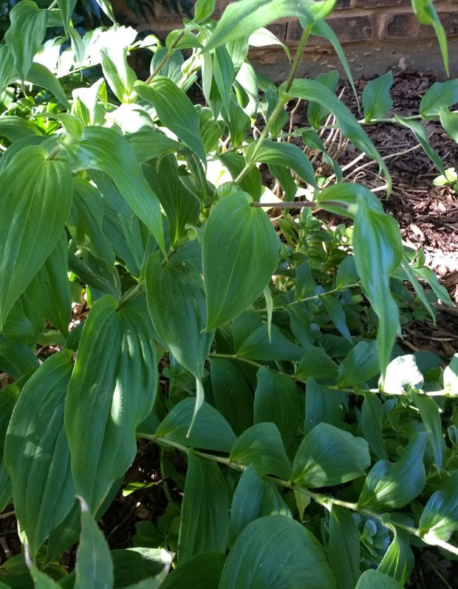
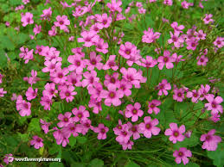
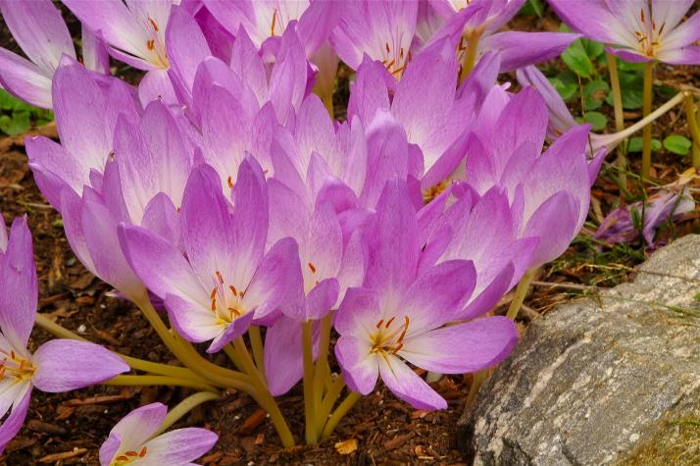
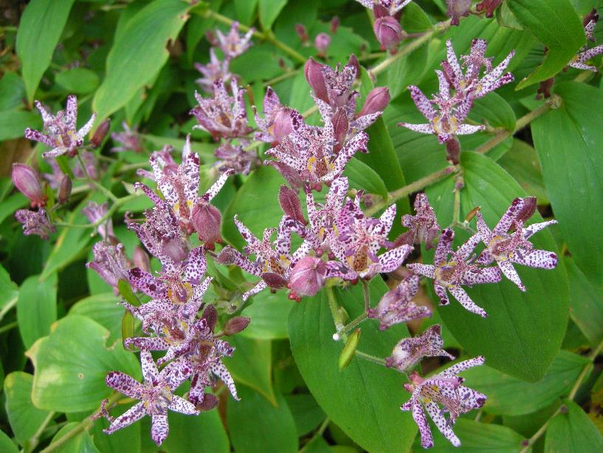
Wood Sorrel, pink
Pink
Toad Lily
Fall Crocus

Slide 17
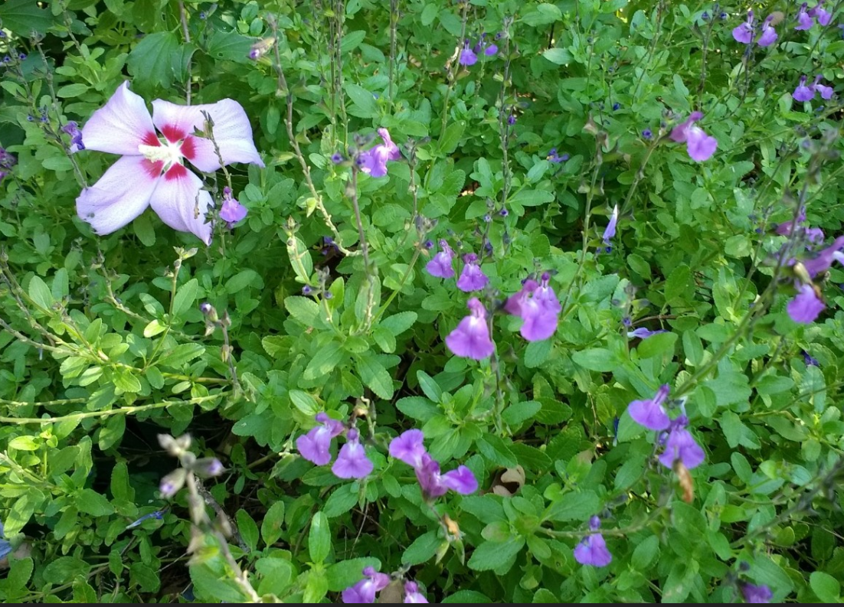
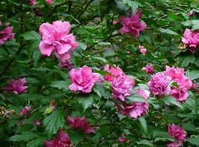
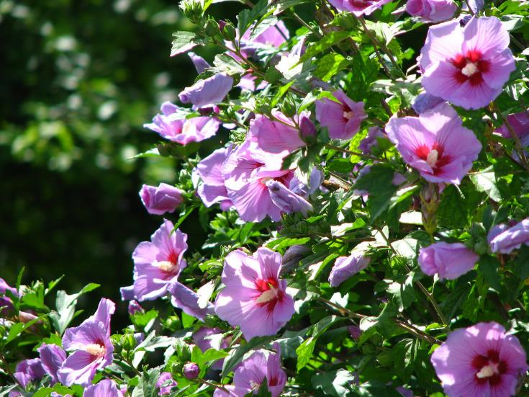
Pink
Purple
Althaea, double pink
Salvia Greggii, purple
Althaea, pink

Slide 18
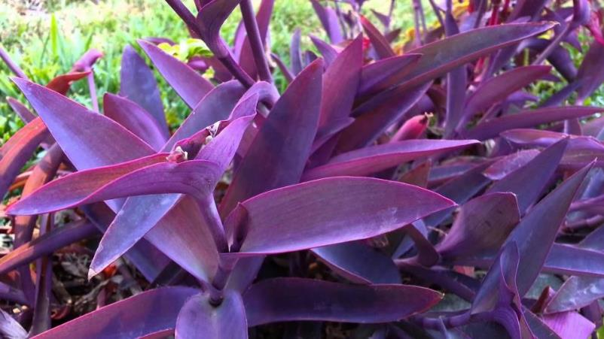
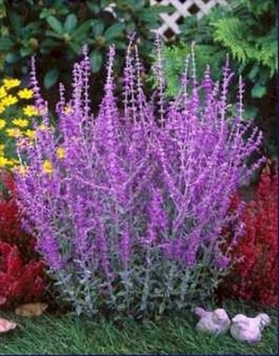
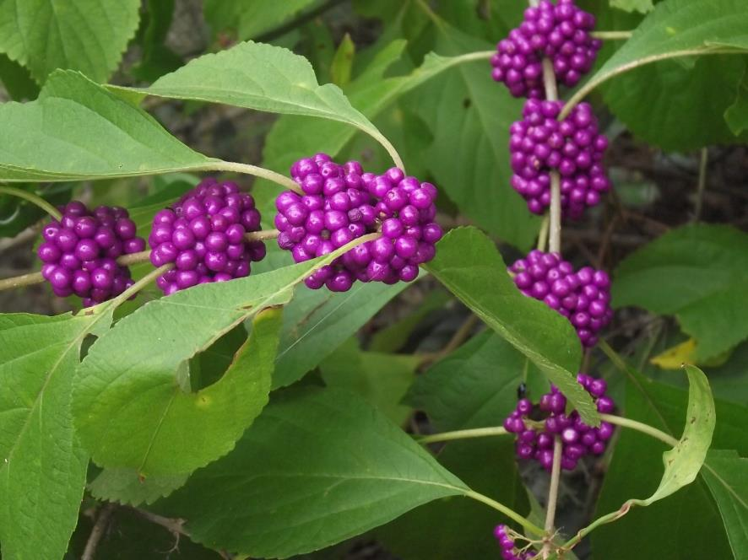
Purple Heart
Purple
American Beautyberry
Russian
Sage

Slide 19
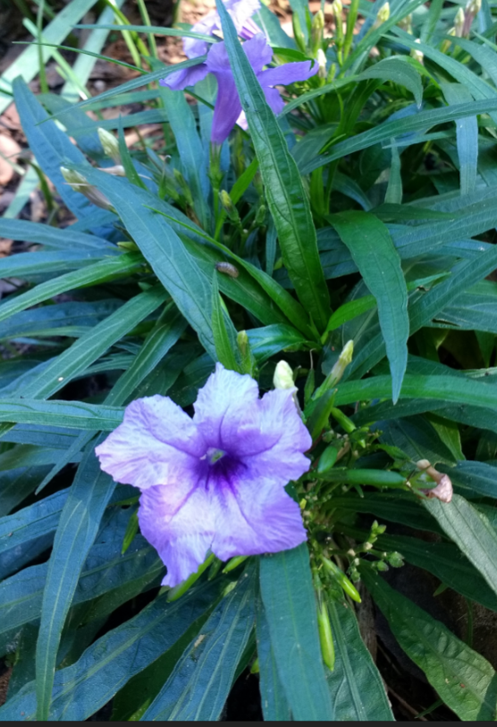
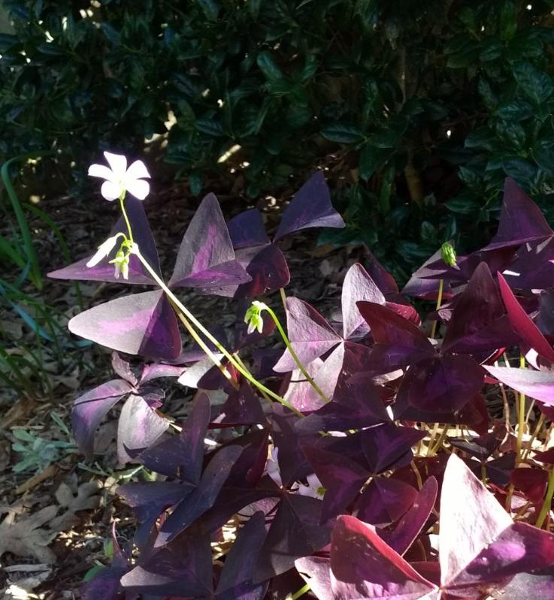
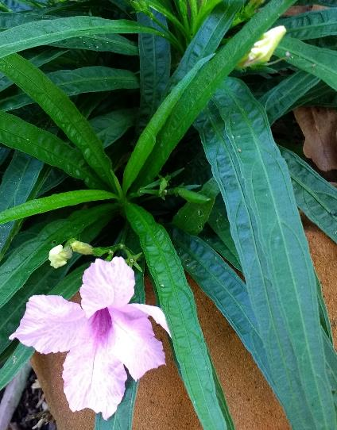
Purple
Dwarf Mexican Petunia
Purple
Oxalis,
Purple Shamrock
Dwarf Mexican Petunia
Pink

Slide 20
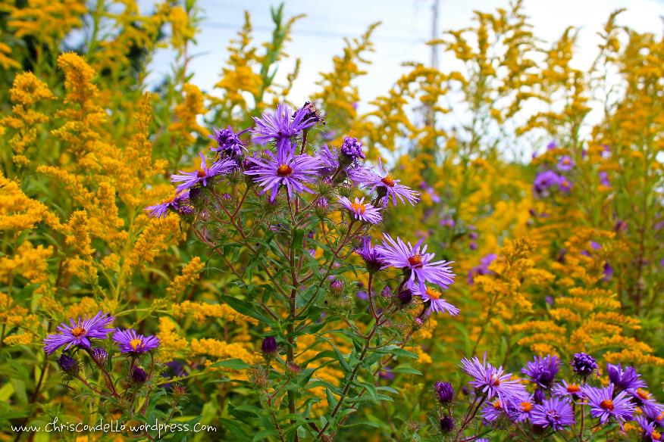
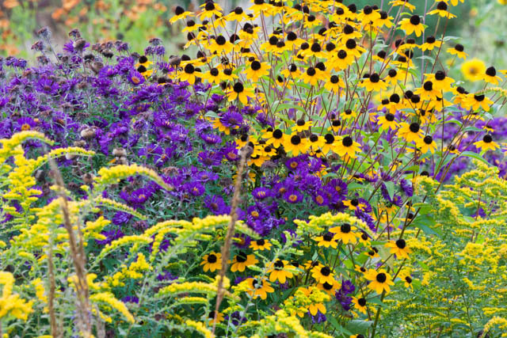
Purple
Orange
Yellow
Goldenrod
Purple Fall Aster
Blackeyed Susan

Slide 21
Phlox -Summer
Perennial Sunflower
Helenium - sneezeweed
Red
Pink
Yellow
Purple

Slide 22
The End

